Slide 1

Data Integration and the ETL Process
Topic 05

Slide 2
Contents
Overview of ETL
Extract
Transform
Load

Slide 3
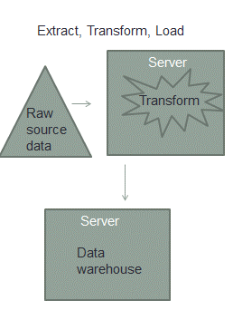
What is ETL?
ETL
ETL (Extract, Transform and Load) is a process in data warehousing responsible for pulling data out of the source systems and placing it into a data warehouse.
The ETL process is critical to a successful data warehouse
ETL must ensure the data loaded into the data warehouse is high-quality, accurate, relevant, useful and accessible
The most time-consuming phase in building a data warehouse as routines must be developed to select the required fields from numerous sources of data

Slide 4

What is ETL?
ETL
ETL involves the following tasks:
The ETL process is often represented by gears icons
Extract : the process of reading data from a source database
Transform : the process of converting the extracted data from its previous form into the form it needs to be in so that it can be placed into another database.
Load : the process of writing the data into the target database.

Slide 5
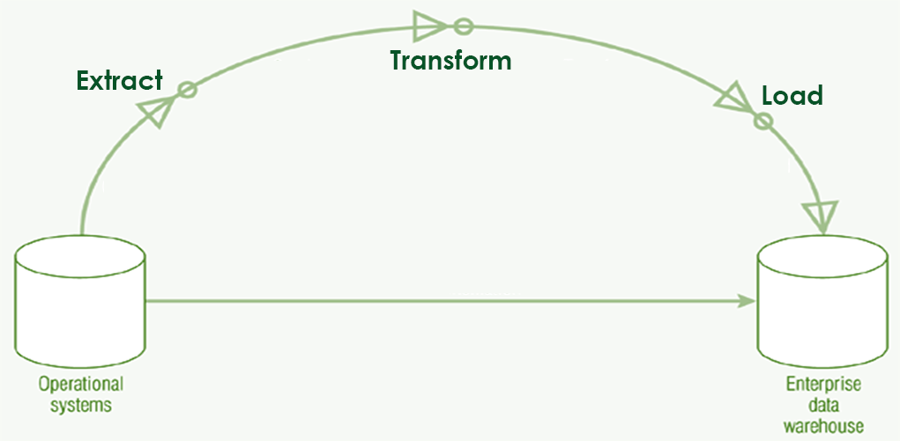
Identify what are the data sources from which data should be extracted
Perform data validation to check if the data meets an expected pattern or structure, if not reject it
Data which passes the check is stored in Staging Area until it is ready for “Transform”

Slide 6
Extract
ETL
The extraction process is the first phase of ETL
In this phase, the required data is identified and extracted from different sources
The extracted data is then held in temporary storage (Staging Area) until the “Transform” and “Load” phases can be executed
During extraction, validation rules are applied to test whether data has expected values essential to the data warehouse
Data that fails the validation is rejected and further processed to discover why it failed validation and remediate if possible.

Slide 7
Fetch the data from Staging Area and perform data cleansing on it to eradicate incorrect or corrupt values
Apply transformation rules to the data to convert to a consistent format suitable for loading to the Data Warehouse

Slide 8
Transform
ETL
The transformation process is the second phase of ETL
In this phase, data is fetched from the staging area, “cleansed” and transformed
Data cleansing or data scrubbing is the process of detecting and correcting (or removing) data anomalies to improve the quality of it
Examples of data anomalies or inaccurate records are:
A delivery date is earlier than the order date
A phone number that contains alphabetical characters
A birthdate that is in the future
A missing value e.g. postal code
Order record refers to a customer id that is missing

Slide 9
Transform
ETL
Besides data cleansing, a series of rules or functions are also applied to the data
Examples of rules / functions that can be applied to the data are:
Translating coded values e.g. Changing all “Male” to “M”
Deriving new calculated values e.g. SalesAmt = Qty*UnitPrice
Deriving aggregated values e.g. pre-calculate total sales for each store
Generating surrogate keys for the Dimensional Model
Splitting a column into multiple columns

Slide 10
Transform
ETL
Some examples of “Dirty Data”
Incorrect Data | Data with values that are obviously incorrect, e.g. Age = 200
Inaccurate Data | Data with values that are correct but inaccurate e.g. Singapore Polytechnic, Malaysia
Business Rules Violation | Data sets that do not comply to business rules, e.g. Payment Types can only be Cash/CreditCard/Cheque but data has “Card”
Inconsistent Data | In one table, customer is called “Mary Tan”, another table, is “Tan Mary”
Incomplete Data | Marketing segmentation data missing because gender of customer was not captured at point of purchase
Non-integrated Data | Customer A with Primary Key 123 on one system and Primary Key 321 on another system

Slide 11
Load the transformed data to the target e.g. the Data Warehouse or Data Marts

Slide 12
Load
ETL
The Load process is the third phase of ETL
In this phase, data is loaded unto the end target, usually a data warehouse or data mart
This process varies widely depending on the requirements of the organization
Some data warehouses may add new data in an historical form at regular intervals — for example, hourly
Some data warehouses may overwrite existing information with cumulative information
Updating extracted data is frequently done on a daily, weekly, or monthly basis

Slide 13
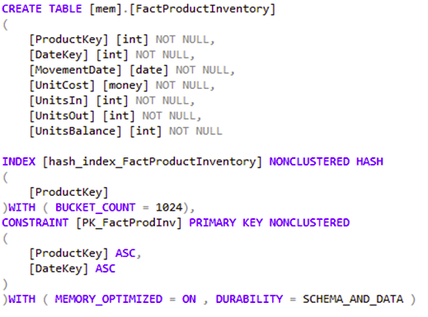
Manual / Software-assisted ETL?
ETL Tools
An organization may choose to buy tools to extract data or may choose to get in-house ETL developers to write the routines instead
What determines the decision is the budget the company wishes to spend
The top-tier ETL products are often perceived as being too expensive so many companies fall back on coding instead
Notes:
http://searchdatamanagement.techtarget.com/feature/Decision-time-Automated-data-integration-tools-versus-manual-coding

Slide 14
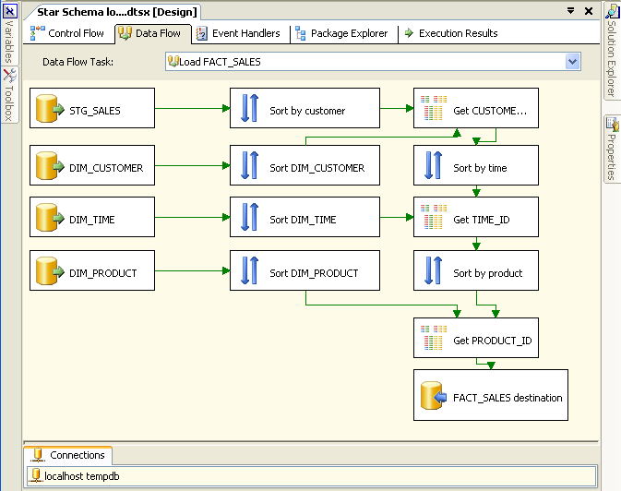
ETL Tools
ETL Tools
Manual ETL done by SQL scripting or “eyeballing” of data on spreadsheets is very time-consuming, error-prone, and seldom provide complete test coverage.
A better option is to use a ETL tool which allow the user to specify instructions via a GUI interface and is much less tedious than manual coding
There are many ETL or data integration tools out there, at all different price points and all levels of complexity.
The next slide shows some of them
Notes:
http://searchdatamanagement.techtarget.com/feature/Decision-time-Automated-data-integration-tools-versus-manual-coding

Slide 15



Commercial/ open-source ETL Tools
ETL Tools
Commercial
SQL Server Integration Services (SSIS) (website)
Oracle Data Integrator (ODI) (website)
IBM Infosphere Information Server (website)
Open-source
Pentaho Data Integration (Pdi, Kettle) (website)
CloverETL (website)
Talend (website)

Slide 16
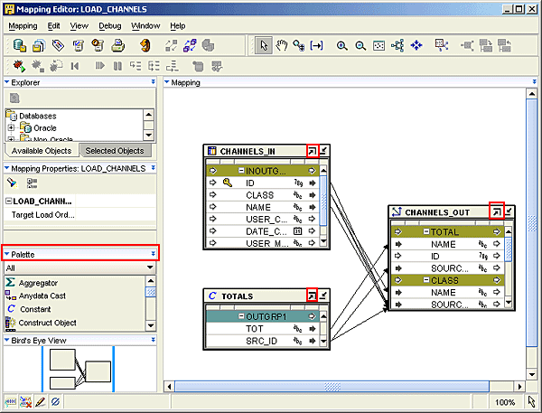
This screenshot shows how Oracle Warehouse Builder, a GUI-based ETL tool allows us to specify which are the ‘channels-in’ (data sources) and how they should be mapped to the ‘channels-out’ (destination in data warehouse), saving us tedious coding (and hair-tearing episodes)
Mapping editor in Oracle Warehouse Builder 11g

Slide 17

ETL Developer
You are an ETL Developer who helps to maintain the data warehouse of BakeWithMe Inc, which sells baking-related products to a global customer base from 10 different countries.
As an ETL Developer, one of your day-to-day job is to ensure that the data from the operational systems from the diverse systems in each country is properly integrated into the central data warehouse.
One of the regular ETL jobs you perform is to import the data for the sales transactions of the Vietnamese customers into the factSales tables.
The SalesData for the Vietnamese customers are given to you at the end of each month in an Excel spreadsheet as shown on the next slide.

Slide 18
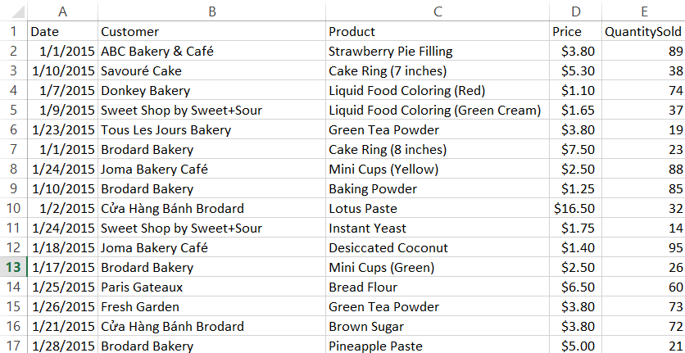
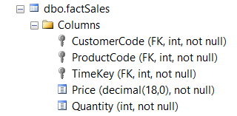
A few pieces of essential data is missing from this Excel spreadsheet which is needed before it can be loaded into the factSales table. Can you tell what are they?

Slide 19
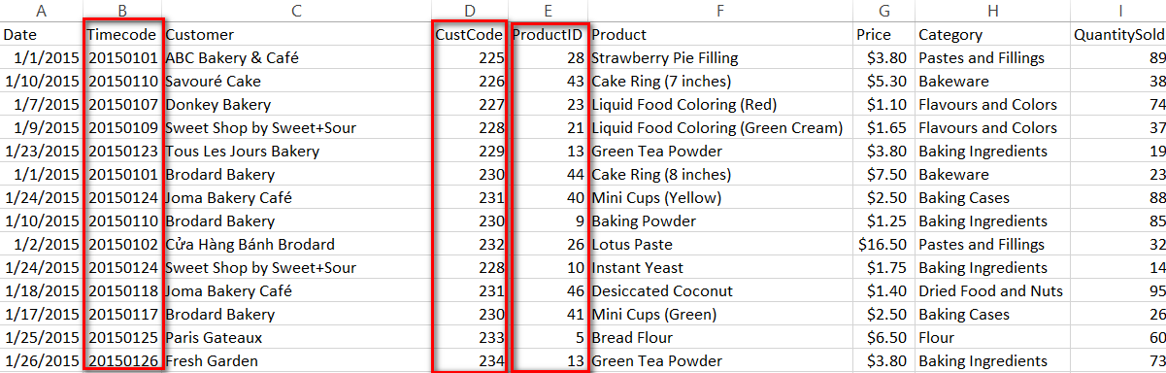
If you spotted that what is missing are the TimeCode, CustomerCode and ProductCode, you are right.
An ETL developer often faces problems like this one.
Data that is given to him cannot be directly pushed to the data warehouse, he needs to write code or manipulate it in some way before it can be loaded.

Slide 20
Step 1: Add Time Key
Step 2: Create Look-up tables
Step 3: Use V-look up to map the keys
As an ETL developer, you would have to transform the original Excel spreadsheet that has 5 columns to the one that has the Customer Code, Product Code and TimeCode
You might have written some SQL code or used Excel macros / operations.
As you can tell, it can be quite tedious.
This is why ETL is one of the most time-consuming process in data warehousing, perhaps even taking up 70% of the time for it!

Slide 21
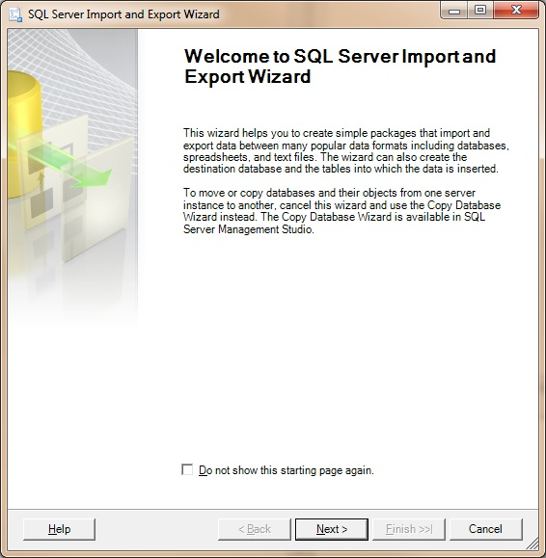
In big organizations, most companies would purchase ETL tools that simplify this task
For example, if the data is close to the correct format, we can use GUI tools like SQL Server Import and Export Wizard to extract the data from the Excel file and load it into the data warehouse
If the data is still not in the correct format, then the ETL developer would need to provide instructions to the ETL tool on how it should transform and load the data (this process is quite complex and beyond the scope of this module)

Slide 22
Using Transact-SQL to copy the data from an OLTP database to a dimension table in a Data Warehouse
INSERT INTO SalesDW..dimProduct(productCode, productName, productLine, productScale, productVendor, productDescription)
SELECT
p.productCode, p.productName, p.productLine, p.productScale, p.productVendor, p.productDescription
FROM
InventoryDB..Products p
If an ETL tool cannot do the job, or perhaps you do not have an ETL tool in-house, then the traditional way is to write SQL statements such as these!

Slide 23
Using Transact-SQL to copy the data from an OLTP database to a Fact table in a Data Warehouse
INSERT INTO
factSales(OrderDate_Key,Customer_Key,Product_Key, Quantity,UnitPrice)
SELECT distinct
d.Date_Key, o.customerNumber, od.productCode, quantityOrdered, od.priceEach
FROM
OrdersDB..orderdetails od, OrdersDB..orders o, SalesDW..dimDate d, CustDB..customers c WHERE
od.orderNumber = o.orderNumber AND CONVERT(DATE,o.OrderDate, 112) = CONVERT(DATE,d.FullDate, 112)
AND o.customerNumber = c.customerNumber

Slide 24
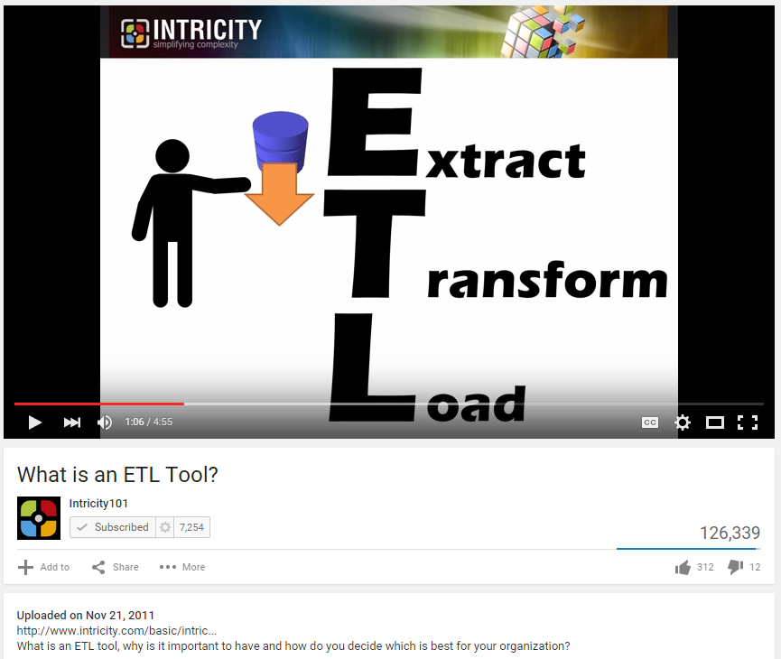
https://www.youtube.com/watch?v=K_FCHYWGGug

Slide 25
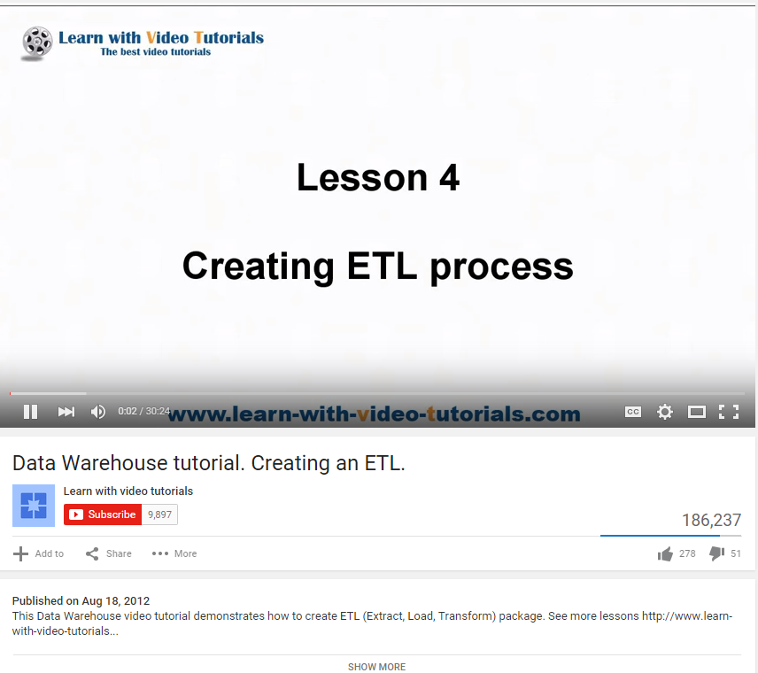
https://www.youtube.com/watch?v=9Akvz2x0az4

Slide 26
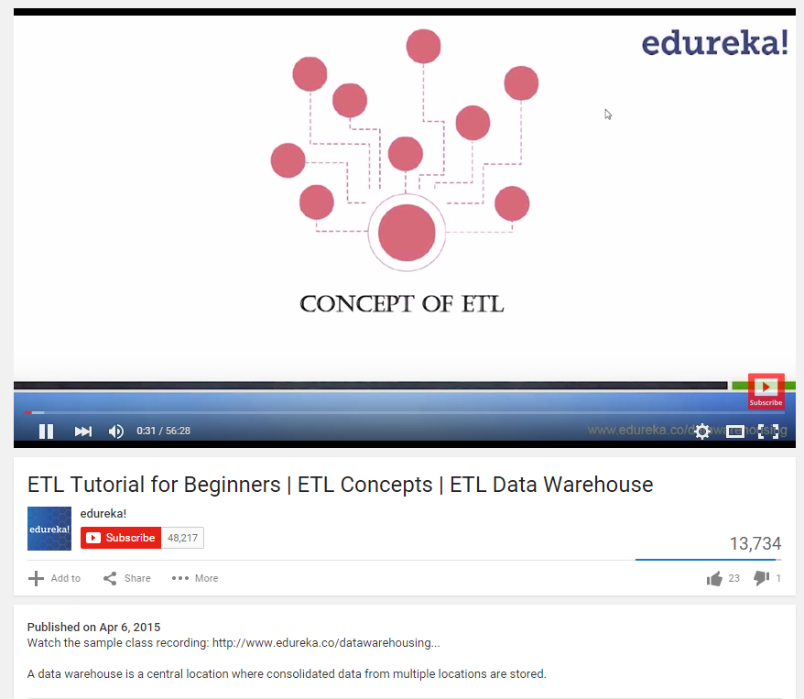
https://www.youtube.com/watch?v=7MOU1l30lXs

Slide 27
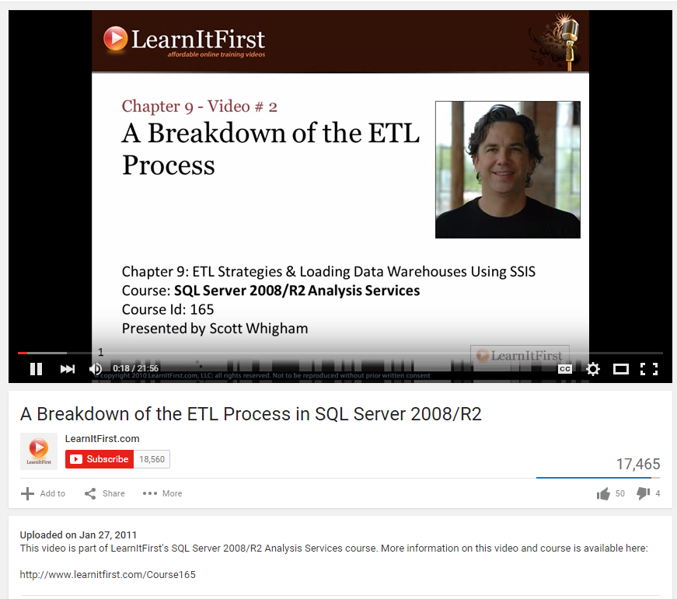
https://www.youtube.com/watch?v=QCMnzdDXBTo

